Slide 1
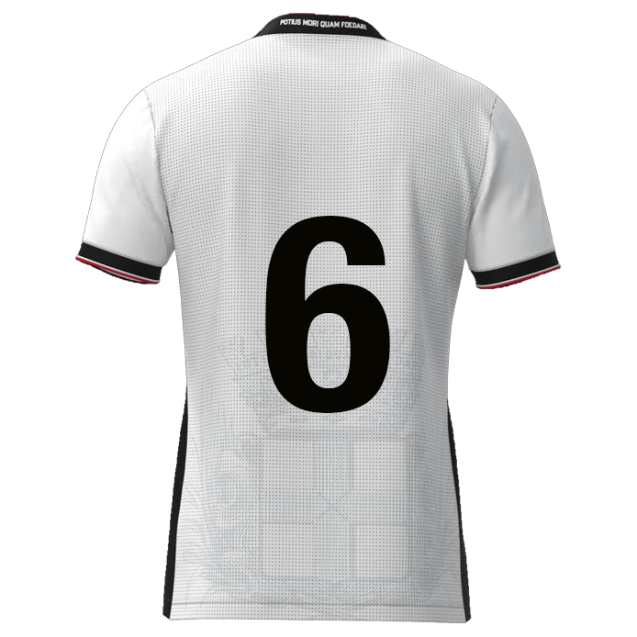

Slide 2

Browse
Foto
DATE: DD-MM-JJJJ
Player name
DD/MM/YYYY: Game / Training
DD/MM/YYYY: Game / Training
DD/MM/YYYY: Game / Training
DD/MM/YYYY: Game / Training
DD/MM/YYYY: Game / Training
DD/MM/YYYY: Game / Training
DD/MM/YYYY: Game / Training
Offensive Passing
xx
xx%
Defensive positioning
Carries
Offensive positioning
Powerplay
Stamina
Speed
Doorzettingsvermogen
Consistency
xxxx
Deep lying playmaker nr. 06
9
11
7
xxxx
8
10
6
xxxx
xx
xx
xx
xx
5
2
4
3
xxxx
1
xxxx

Slide 3
Deep lying playmaker | Rating | Multiplication factor | Result
Offensive Passing | 0 | 1,1 | 0
Defensive positioning | 0 | 1,1 | 0
Carries | 0 | 1 | 0
Offensive positioning | 0 | 1 | 0
Power play | 0 | 1,1 | 0
Stamina | 0 | 1,1 | 0
Speed | 0 | 1 | 0
Determination | 0 | 1,1 | 0
Consistency | 0 | 1 | 0
 |  | Gemiddelde rating | 0,00

Slide 4
Deep lying playmaker #06
9
11
7
Offensive Passing
Powerplay
Determination
10
8
Defensive positioning
Stamina
6
5
2
4
3
Carries
Speed
Consistency
1
Offensive positioning

Slide 5
Offensive Passing
Defensive positioning
Carries
Offensive positioning
“Open play pass <10m (under pressure or through the lines) or open play pass >30m”
“Prevent the direct opponent from finishing, crossing, dribbling or passing by defending well”
'"Dribble with the ball resulting in
>5m forward displacement”
“Ball receptions in halfspace
and/or final third”
Speed of actions
Type of pass
Both legs
Direction & timing
Pace & height
Preparation
Frequency?
End result
?
Man & ball?
Body position
High or low line?
Danger recognition
Distance lines
Press opponent
Cover passing lines
?
Mobility
Pace & control
Which leg(s)
Covering distance
Space recognition
Frequency
End result
?
Space recognition
Scanning
Awareness
Overload / 3rd man
Reachable
Rotating
Areas of play
?
Power play
Stamina
Speed
Determination
“Attempts by physical strength and forceful challenges to dominate opponents in duels”
“Sustain prolonged effort and maintain performance throughout a match without excessive fatigue”
“Top speed and acceleration capabilities”
“Showing strong will, persistence, and commitment to succeed, even in difficult situations”
Strong body part
Groundduels
Aerial duels
Timing
Preparation
Frequency?
End result
?
Intensity
Total distance
HI-runs
Sprints
Maintaining 90 mins
Average mins p/g
?
Top speed
Acceleration
Stride length
Big / small distance
First meters
End result
?
Emotion control
Behaviour (by result)
Mourning
Inspiring others
Never give up
Fight until the end
Always 100%
?

Slide 6
Consistency
“Perform at a similar level of quality repeatedly over time, across matches or actions”
Steady
Influential
Solid
In control
Conscious
React after mistakes
Dealing with stress
?

Slide 7



Slide 8
Defensive
positioning

Slide 9
Carries

Slide 10
Offensive
positioning

Slide 11
Power play

Slide 12
Stamina

Slide 13
Speed

Slide 14
Determination

Slide 15
Consistency

